Slide 1
Team B - Used Napkin
Diet Manager - Release 1
Josh Schrader Kevin Gleason Patrick Lennon
Sean Decker Neil Hiranandani
Notes:
Explain that we chose to use MVC for this project because
MVC supports faster development, as multiple developers can work on different pieces concurrently
Changing functionality of one section does not affect other functionality
Explain that we chose to use the composite pattern because
The idea of basic foods vs recipes does not matter to the program as a whole, and the composite pattern allows both to be treated in the same way
We chose to use a CLI output because it allows us to work more directly with the system, and can easily be changed later.
Challenges:
Successes:
changes made:
CSV turned into controller that’s used in conjunction with diet controller
Easier to make a non-generic csv parser
Determined the user can’t delete from global food list because it would cause complications with other users that tried to add food that once existed
User now has a history of diet logs vs the initial design of having just one diet log object - this allowed for easier reference to each diet log’s information and the ability to correlate the information received
We aren’t allowing the user to delete food from previous dates
challenges:
Food serving - due to an oversite in the initial design of the system, we needed to add a copy function to the abstract food class in order to prevent globally overwriting the serving size of each similar food in the log
We are thinking of removing serving size of food all together and making it a separate class down the line
Naming conventions - caused confusion between team members for what things were responsible for doing

Slide 2
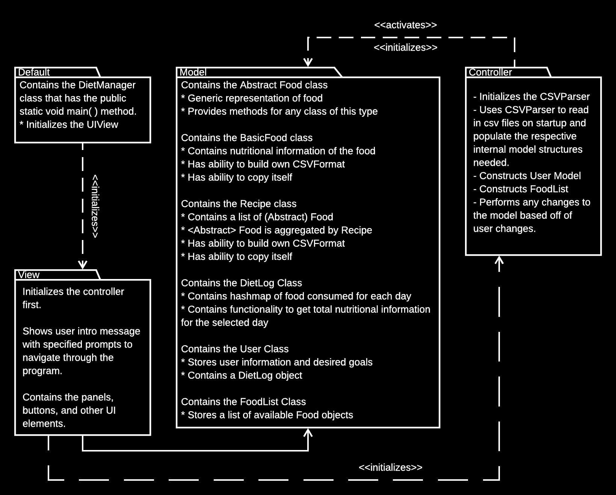
Subsystem Structure

Slide 3
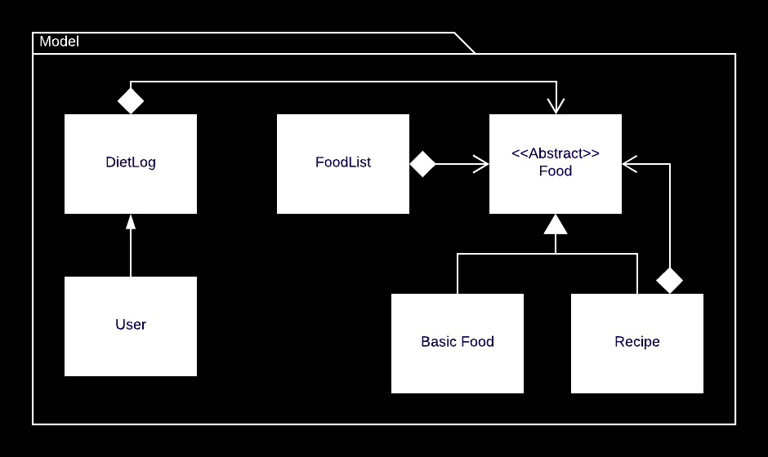
MVC - Model

Slide 4

MVC - View

Slide 5
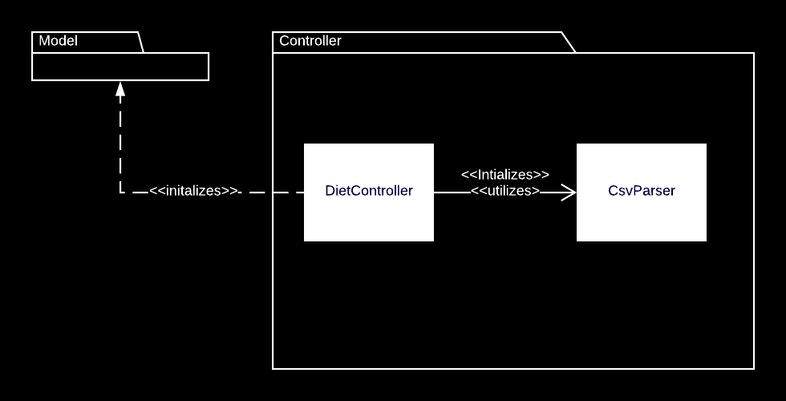
MVC - Controller

Slide 6
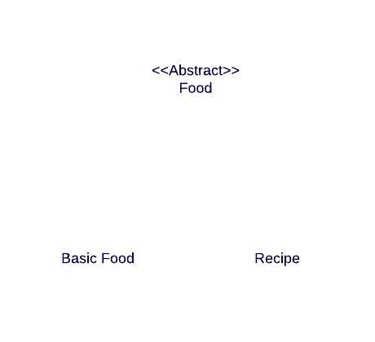
Composite Pattern

Slide 7
Challenges

